Slide 1
Software Systems Design and Integration
Lecture 13: Service-oriented Architectures and Web Services

Slide 2
Aims and Objectives
To understand the principles and the technologies for building SOA
To understand the Web Services and their role in Service-oriented Architectures
To learn how to develop Web Services
To compare SOAP-based and RESTful Web Services

Slide 3
Content
1 Service-oriented Architectures (SOA)
  SOA as a Software Architecture for Distributed Data Processing
  SOA as a Platform for System Integration
  Data formats used for system integration
2 Web Services Technology (WS)
  3 Developing RESTful Web Services
4 Developing SOAP-based Web Services
5 Platforms for deploying Web Services

Slide 4
1 Service-oriented Architectures (SOA)
SOA is a business-centric IT architectural approach that supports system interoperability
  Build for the Internet, can work over intra-and extranets
Example: Supply Chain Management
SOA is a platform-independent, language-independent and based on existing technologies
  HTTP (RESTful WS), XML (XML-RPC, SOAP), JSON
SOA and Web
  Web 2.0: Component-based rather than page-based
  Examples: YouTube, PayPal, Google, eBay, etc
  Web 3.0: Semantic Web Services
  Examples: Swoogle

Slide 5
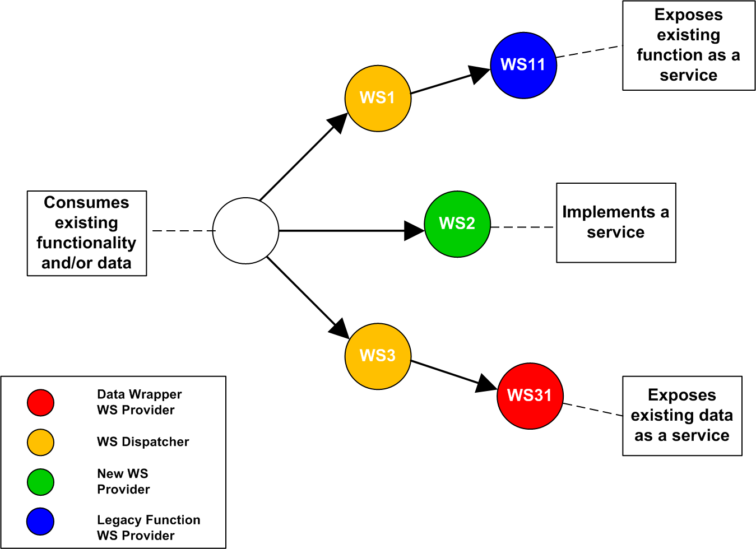
SOA as a Software Architecture for Distributed Data Processing

Slide 6
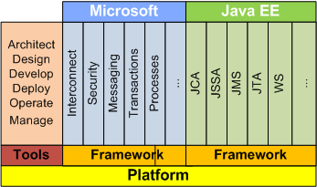
SOA as a Platform for System Integration

Slide 7
Data formats used for system integration
CSV (Comma-Separated Values) - exchanging text, with values separated by columns (mainly for database exchange and within information systems)
XML (eXtendible Meta Language) – exchanging primitive data types with names, types and values tagged using XML tags (anywhere)
JSON (Java Script Object Notation) – exchanging Java Script data in a object-oriented encoding format (only on the Web)

Slide 8
Standards related to Interoperability
SOAP (Simple Object Access Protocol) – originally developed by Microsoft and IBM, currently maintained by W3C
UDDI (Universal Description, Discovery and Integration) – maintained by OASIS
BPEL (Business Process Execution Language) – originally developed by IBM, currently maintained by W3C

Slide 9
Content
1 Service-oriented Architectures (SOA)
2 Web Services Technology (WS)
    Software Architectures of Service-oriented Web Applications
    RESTful Web Services
    SOAP-based Web Services
  3 Developing RESTful Web Services
4 Developing SOAP-based Web Services
5 Platforms for deploying Web Services

Slide 10
2 Web Services Technology
The software architecture of WS applications is based on the proxy pattern with client-side and server-side proxies; both proxies are automatically generated by the corresponding libraries
Two types of Web Services
  RESTful – light, use any XML API available in the Web tier (i.e., JAX in Java, part of Java SE)
  SOAP-based – heavy, use implementation of standard SOAP API (i.e., Java WS) and/or messaging (i.e., JMS)
Both types use XML, but it is generated, processed using the standard libraries and remains hidden – but can be also processed explicitly in the case of document-style Web service

Slide 11
2.1 Software Architecture of Service-oriented Applications
Based on the proxy pattern; typically with broker, but in this case the broker is the Web itself (no need for a separate broker)
Use XML for data exchange during comunications, the same between the consumer and the provider and between the provider and the proxy (WS can be consumers themselves)
Text based (HTTP is the protocol)
Can be extended to include dynamic service discovery using central repositories (UDDI can be used to access WS registries on the Web)

Slide 12
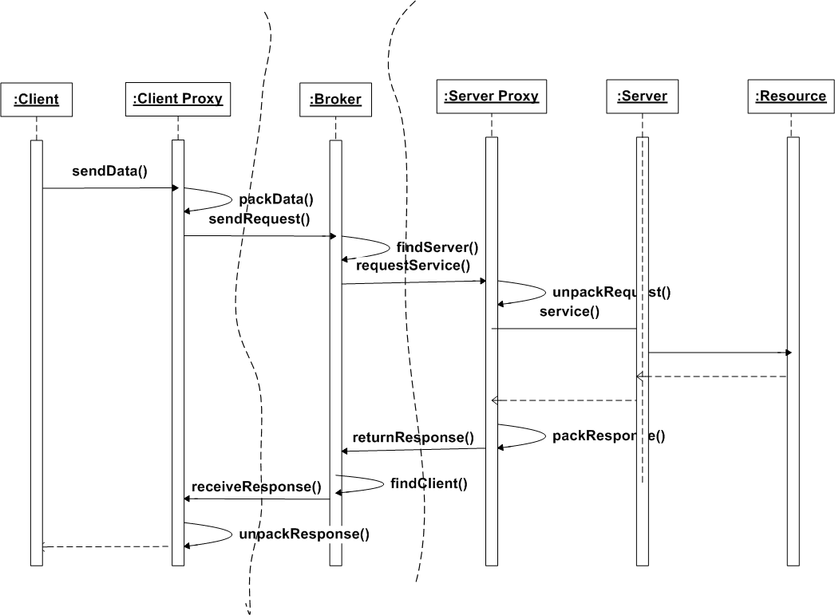
Broker Pattern with Proxy

Slide 13
2.2 RESTful Web Services
Based on the concept of REpresentational STate for transformation of the Internet resources remotely
  All resources have an URI – i.e., http://localhost/MyApp/myResource
  All resources have a state which is synchronized during communications between the client and the server
  All remote processing is requested using standard HTTP methods only, so no additional protocol is needed
Implement typical data manipulation operations (Store/Retrieve/Update/Delete)

Slide 14
JAX-RS Request Methods
Annotation | Description
@GET | The Java method annotated with this request method designator will process HTTP GET requests. The behavior of a resource is determined by the HTTP method
@POST | The Java method annotated with this request method designator will process HTTP POST requests. The behavior of a resource is determined by the HTTP method
@PUT | The Java method annotated with this request method designator will process HTTP PUT requests. The behavior of a resource is determined by the HTTP method.
@DELETE | The Java method annotated with this request method designator will process HTTP DELETE requests. The behavior of a resource is determined by the HTTP method
@HEAD | The Java method annotated with this request method designator will process HTTP HEAD requests. The behavior of a resource is determined by the HTTP method.

Slide 15
JAX-RS Request Parameters
The specific format of the parameters in the remote invocation is not standardized
The body of the HTTP message could be any MIME-type (text, message, image, video, etc), including XML and JSON
Very simple, does not require additional protocols – but not fully standard-based
Popular among JavaScript programmers, but also fully supported by Java EE using JAX-RS API

Slide 16
JAX-RS Endpoints
The Internet resources subject to state transformation using RESTful WS are simply Java classes with request scope (no session)
They are deployed to the Web container of the Java EE server (no need for full Java EE server – i.e., Tomcat is sufficient)
During the deployment the container creates a wrapper servlet automatically, which will be used to processes the HTTP requests directed to the endpoint

Slide 17
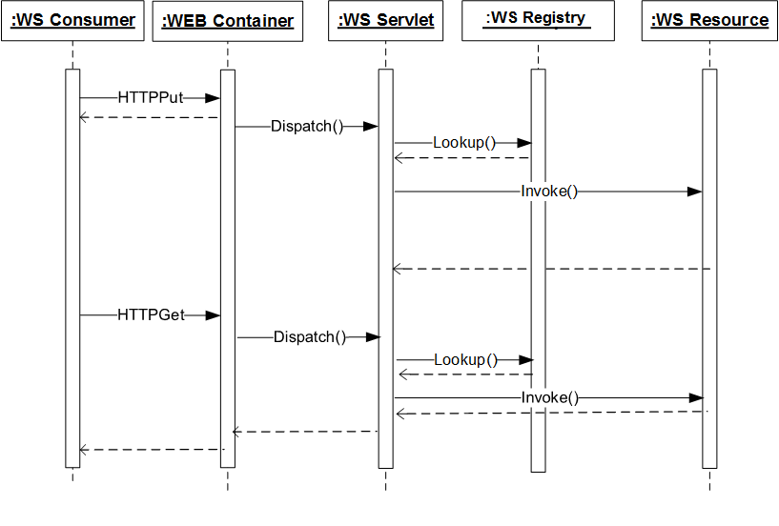
Processing of RESTful WS requests by the Web Container

Slide 18
2.3 SOAP-based Web services
Result of standardization efforts, initiated by Microsoft and IBM and supported by Sun, Oracle...
Based on a separate layer on top of XML (SOAP)
Much more complex, but allows generation of the proxies and hides the XML and SOAP layers
SOAP has extensions to support additional specifications, such as security, attachments, etc., not available with RESTful service

Slide 19
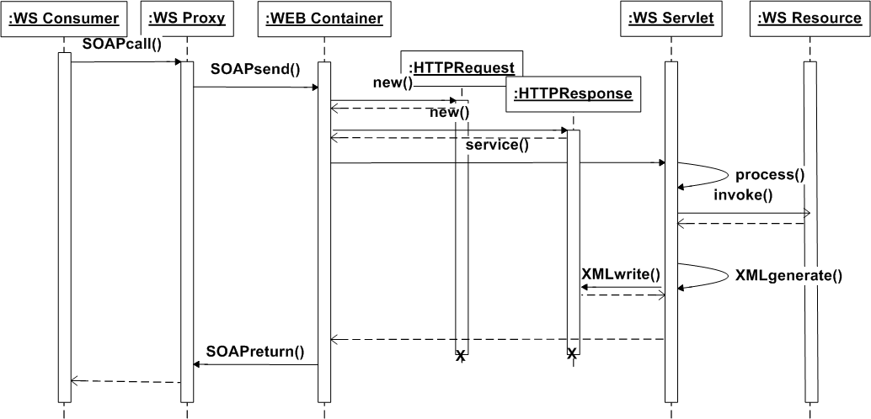
Processing of SOAP WS requests by Web Container

Slide 20
Use WSDL (Web Services Description Language) for specification of the communication format
In J2EE 3 Web Services API wasn’t standard part, only vendor-specific extension(I used an Oracle implementation which was based on the PL/SQL proprietary implementation)
In J2EE 4 Sun added a package JWSDP, which supported WS, but later on revoked it
Since Java EE 5 it has been fully standardized and included as part of Java EE framework

Slide 21
Web Service Description Language (WSDL)
Automatically retrieved by the programming language library after parsing the WSDL file using suitable XML parser
Information about
  the name of the service
  location of the Web service (URL endpoint)
  its type (document-style, RPC-style)
  the methods exposed (messages)
  the parameters needed for invoking them

Slide 22
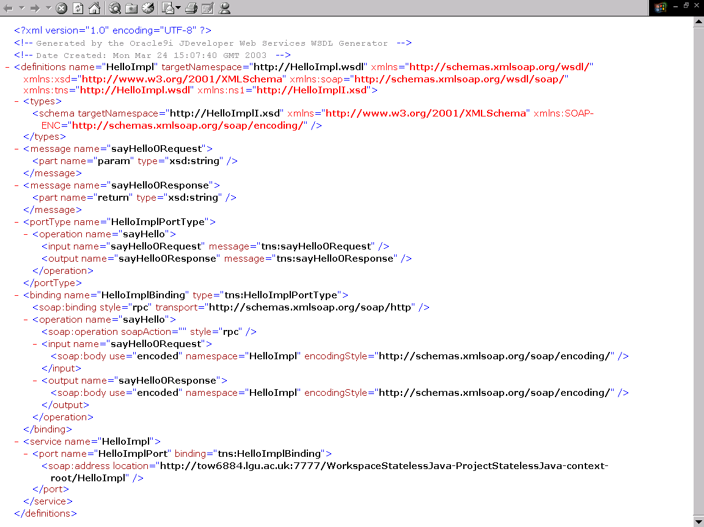

Slide 23
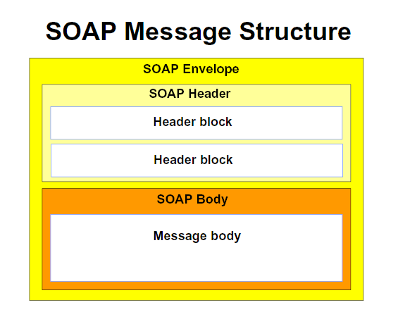
SOAP Messages
SOAP has three parts, SAAJ adds one more: message envelop to encode the rules for wrapping the data, message header with conventions for the remote operations, message body and attachment

Slide 24
Example: SOAP file (sent by the client)
POST http://tow6884.lgu.ac.uk:7777/WorkspaceStatelessJava-ProjectStatelessJava-context-root/HelloImpl HTTP/1.1
Host: tow6884.lgu.ac.uk :7777
Proxy-Connection: Keep-Alive
Connection: TE
TE: trailers, deflate, gzip, compress
User-Agent: RPT-HTTPClient/0.3-3
SOAPAction: ""
Accept-Encoding: deflate, gzip, x-gzip, compress, x-compress
Content-type: text/xml; charset=utf-8
Content-length: 443
<?xml version = '1.0' encoding = 'UTF-8'?>
<SOAP-ENV:Envelope xmlns:SOAP-ENV="http://schemas.xmlsoap.org/soap/envelope/"
xmlns:xsi="http://www.w3.org/2001/XMLSchema-instance"
xmlns:xsd="http://www.w3.org/2001/XMLSchema">
<SOAP-ENV:Body>
<ns1:sayHello xmlns:ns1="HelloImpl" SOAP-ENV:encodingStyle="http://schemas.xmlsoap.org/soap/encoding/">
<param xsi:type="xsd:string">Vassil</param>
</ns1:sayHello>
</SOAP-ENV:Body>
</SOAP-ENV:Envelope>

Slide 25
Example: SOAP file (received back)
HTTP/1.1 100 Continue
HTTP/1.1 200 OK
Date: Mon, 24 Mar 2003 20:00:36 GMT
Cache-Control: private
Server: Oracle9iAS/9.0.2 Oracle HTTP Server Oracle9iAS-Web-Cache/9.0.3
Content-Length: 551
Content-Type: text/xml; charset=utf-8
Connection: Keep-Alive
Keep-Alive: timeout=5, max=999
<?xml version = '1.0' encoding = 'UTF-8'?>
<SOAP-ENV:Envelope xmlns:SOAP-ENV="http://schemas.xmlsoap.org/soap/envelope/"
xmlns:xsi="http://www.w3.org/2001/XMLSchema-instance"
xmlns:xsd="http://www.w3.org/2001/XMLSchema">
<SOAP-ENV:Body>
<ns1:sayHelloResponse xmlns:ns1="HelloImpl"
SOAP-ENV:encodingStyle="http://schemas.xmlsoap.org/soap/encoding/">
<return xsi:type="xsd:string">Hello Vassil! This is a stateless Java class.
The current time is Mon Mar 24 20:02:20 GMT 2003
</return>
</ns1:sayHelloResponse>
</SOAP-ENV:Body>
</SOAP-ENV:Envelope>

Slide 26
Content
1 Service-oriented Architectures (SOA)
2 Web Services Technology (WS)
  3 Developing RESTful Web Services
    3.1 Implementing JAX RS endpoint
    3.2 Configuring the service
    3.3 Registering the service
    3.4 Parameter Specification
4 Developing SOAP-based Web Services
5 Platforms for deploying Web Services

Slide 27
3 Developing of RESTful Web Services using JAX-RS
The current support is based on JAX-RS API, which was included for the first time in Java EE6
Does not include client-side API, because the client uses standard HTTP – any standard HTTP client can send the request

Slide 28
3.1 Implementing JAX RS endpoint
  The Web services are Java classes annotated with annotation @PATH from the package javax.ws.rs
    They cannot be abstract and must have a null-argument constructor
  Their public methods can be annotated with request method designator (i.e., @GET) to provide implementation of the remote requests over HTTP
  Uses also @Produces and @Consumes annotation for both the class and the methods to specify the data types in and out of the service

Slide 29
Example: RESTful Web Service resource class
import javax.ws.rs;
@Produces(“text/plain”)
@Consumes(“text/plain”)
@Path(“/Welcome”)
public class WelcomingRESTResource{
private static String msg = “Hello, Welcome to the RESTful World!”;
public WelcomingRESTResource(){
@GET public getTextMsg(){
return msg;
}
@PUT public void putTextMsg(String msg){
msg=msg;
}
}

Slide 30
3.2 Configuring the service
(in Java EE6/Glassfish 3)
Configuration file web.xml file
Generic, one entry for all deployed Web Services within the application
Example:
  <servlet>
  <servlet-name>ServletAdaptor</servlet-name>
  <servlet-class>
  com.sun.jersey.spi.container.servlet.ServletContainer
  </servlet-class>
  <load-on-startup>1</load-on-startup>
  </servlet>
  <servlet-mapping>
  <servlet-name>ServletAdaptor</servlet-name>
  <url-pattern>/resources/*</url-pattern>
  </servlet-mapping>

Slide 31
3.3 Registering the service
(for Java EE7/Glassfish 4)
No need for configuration
Registration of the service directly using annotations
Example:
import java.util.HashSet;
import java.util.Set;
import javax.ws.rs.ApplicationPath;
import javax.ws.rs.core.Application;
@ApplicationPath("/rest")
public class WebServices extends Application {
@Override
public Set<Class<?>> getClasses() {
final Set<Class<?>> services =
new HashSet<Class<?>>();
services.add(ServiceResource.class);
return services;
}
}

Slide 32
3.4 Parameter Specification
More than one parameters are possible
Annotation @PathParam for each parameter of the exposed methods which can be passed during the invocatio~”n of the service remotely
Example:
  @Path("students/{st_id,st_name}")
  public class StudentInfo {
  @GET
  Student getStudent(@PathParam("st_id" String id){
  //...
  }
  }

Slide 33
Summary of JAX-RS Annotations
Annotation | Description
@Path | A relative URI path indicating where the Java class will be hosted: for example, /helloworld. You can also embed variables, asking for a user as in /helloworld/{username}.
@PathParam | A type of parameter that you can extract for use in your resource class. URI path parameters are extracted from the request URI, and correspond to the @Path annotation.
@QueryParam | A type of parameter that you can extract for use in your resource class. Query parameters are extracted from the request URI query parameters.
@Consumes | Specifies the MIME media types of representations a resource can consume that were sent by the client.
@Produces | Specifies the MIME media types of representations a resource can produce and send back, for example, "text/plain".
@Provider | For HTTP requests, the MessageBodyReader maps an HTTP request entity body to method parameters. A return value is mapped to an HTTP response using a MessageBodyWriter.

Slide 34
Content
1 Service-oriented Architectures (SOA)
2 Web Services Technology (WS)
  3 Developing RESTful Web Services
4 Developing SOAP-based Web Services
  4.1 JAX-WS Web Service endpoint
  4.2 JAX-WS Endpoint Lifecycle Methods
  4.3 JAX-WS parameter data types
  4.4 Client-side Web Service Proxy Generation
  4.5 Client-side Web Service Application Development
5 Platforms for deploying Web Services

Slide 35
4 Developing SOAP-based Web Services using JAX-WS
The endpoints could be standard Java class (no need for EJB container), stateless session EJBs or singleton session EJBs (statefull EJBs cannot be end-points – why?)
  The SOAP requests are intercepted by the SOAP servlet wrapper, which is deployed to the Web container to processes the incoming SOAP calls
  The wrapper converts the remote calls to a local call to the endpoint of the service using JAX-WS API and passes the parameters to the endpoint for processing
  The endpoint executes the remote methods as specified in the original SOAP call

Slide 36
4.1 JAX-WS Web Service endpoint
JAX-WS Web Service implementation is a Java class which is not abstract and not final
  The class must be annotated using @WebService
  Each JAX-WS class must have zero arguments constructor
The remote methods of the class to be exposed as a Web service are public, not final and not static
  Each exposed method must be annotated using @WebMethod

Slide 37
Example: JAX-WS Endpoint Implementation
package example.soap;
import javax.jws.*;
@WebService
public class MyWebService {
@WebMethod
public Styring sayHello(String name){
return ("Hello, "+ name);
}
}

Slide 38
(cont.) Endpoint Configuration
<servlet>
<servlet-name>HelloService</servlet-name>
<servlet-class>example.soap.MyWebService
</servlet-class>
<load-on-startup>1</load-on-startup>
</servlet>
<servlet-mapping>
<servlet-name>HelloService</servlet-name>
<url-pattern>/hello</url-pattern>
</servlet-mapping>

Slide 39
4.2 JAX-WS Endpoint Lifecycle Methods
All JAX-WS Endpoint implementations (both Web classes and EJB classes) can have lifecycle methods associated with them
  @postConstruct: called by the corresponding container before the class becomes active
  @preDestroy: called by the container before the endpoint is removed from the container
The JAX-WS Endpoints implemented using Web components are like multi-threaded servlets, which run a separate instance per each client request
The JAX-WS Endpoints implemented as EJBs can use pools of beans to process the client requests

Slide 40
4.3 JAX-WS parameter data types
SOAP is embedded in XML, so it can use any XML datatype
The binding of Java data types to XML data types is specified in JAXB binding specification
  Basic Java data types, including String object data type, are automatically supported in JAX-WS
  Using JAXB mapping it is possible to exchange complex XML data types specified in a separate XML Schema
  For exchanging Java object data types some explicit JAXB conversion is required and it can be specified programmaticaly

Slide 41
Example: JAXB annotated class for SOAP exchange using JAX-WS
import javax.xml.bind.annotation.XmlType;
@XmlType
public class Student {
private String id;
private String name;
private int age;
public Student(){}
public String getName() {
return name;
}
public void setName(String nm) {
this.name=nm;
}
...
}

Slide 42
(cont.) SOAP response
<?xml version = “1.0” encoding=“UTF-8”?>
<soapenv:envelope
xmlns:soapenv=“http://schemas.xmlsoap.org/soap/envelope/”
xmlns:xsd=“http://www.w3.org/2001/XMLSchema”
xmlns:ns1=“http://server/”>
<soapenv:body>
<ns1:getStudentResponse>
<return>
<id>S0123456789</id>
<name>Bob Hoskins</name>
<age>23</age>
</return>
</ns1:getStudentResponse>
</soapenv:body>
</soapenv:envelope>

Slide 43
4.4 Client-side Web Service Proxy Generation
Eclipse wsimport utility
Apache Ant tool and build.xml proxy descriptor
<project default="wsimport-bin" basedir=".">
<property name="wsdl" value="http://localhost:8080/MVCSOAPApp/StMksService?WSDL"/>
<property name="package" value="londonmet.cs.j2ee.web"/>
<property name="classes-dir" value="bin"/>
<property name="src-dir" value="src"/>
<target name="wsimport-bin">
<exec executable="wsimport">
<arg line="-keep -s ${src-dir} -d ${classes-dir}
-p ${package} ${wsdl}"/>
</exec>
</target>
</project>

Slide 44
4.5 Client-side Web Service Application Development
The WS client can be either standalone application or container-deployed component (servlet or EJB)
Starting point for the development is the WSDL file, which is generated by the WS and can be obtained online from the Web service endpoint
http://localhost:8080/MyWebService/HelloService?WSDL
Next step is to generate the proxy for the Web service, which can be done on the client-side using wsimport utility from the WSDL file of the service
Finally the consumer can be deployed together with the proxy to the client platform

Slide 45
Example: Web Service Consumer
public class MVCSOAPClient {
public MVCSOAPClient () {
}
public static void main (String[] args) {
String stud_id="00000001";
String mod_code="CS6002";
System.out.println("*** Web Service Client Started ***");
try{
StudentMarksService service = new StudentMarksService();
StudentMarks port = service.getStudentMarksPort();
System.out.println("*** Web Service Proxy Created ***");
System.out.println("Result for student " + stud_id);
System.out.println("in module "+ mod_code + " is: " +
port.getStudentMark(stud_id,mod_code));
} catch (Exception e) {
System.out.println("*** Web Service Not Available ***");
}
}
}

Slide 46
Content
1 Service-oriented Architectures (SOA)
2 Web Services Technology (WS)
  3 Developing RESTful Web Services
4 Developing SOAP-based Web Services
5 Platforms for deploying Web Services
  5.1 General Purpose Java EE Application Servers
  5.2 Specialized Web service providers

Slide 47
5 Platforms for Deploying Web Services
Vendor dependence: commercial (e.g. Microsoft, Oracle, IBM, SCO) and public domain (e.g., Apache Tomcat with Axis, Glassfish)
Technological stack: general-purpose (Java EE-compliant, .Net compliant) and specialized (RESTful or SOAP WS support only)
Java compliance of the server:
J2EE 1.2 (1999) - no XML and no WS support
J2EE 1.3 (2001) - support for XML (JAX API) but not for WS
J2EE 1.4 (2003) - non-standard support for SOAP WS (JWSDP)
Java EE 5 (2006) - standard support for SOAP WS (JAX-WS)
Java EE 6 (2009) - standard support for RESTful WS (JAX-RS)
Java EE 7 (2013) – additional support for WebSockets and JSON objects in WS

Slide 48
5.1 General Purpose Java EE Application Servers
History
  Sun JWS (Web container),
  BEA WebLogic (EJB container),
  Netscape LDAP (external JNDI provider, now OpenLDAP)
  IBM MQ (external JMS provider, now Apache Kafka)
  IBM SOAP4J (external SOAP provider, now Apache Axis)
Java EE application servers (all include WS support):
  BEA Web Logic – the best commercial server (from Oracle)
  IBM Web Sphere – very heavy server with Eclipse and DB2 support
  Jboss – with its own JMS provider (from RedHat)
  Sun Glassfish – based on Netscape AS (now in the public domain)

Slide 49
5.2 Specialized Web service providers
History: Microsoft and IBM (first SOAP implementations)
Specialized Web Service Providers:
  Mindelectric GLUE - one of the simplest SOAP servers around, now obsolete
  Zvon WASP - one of the best servers for deploying Web services available
  Apache Axis - revised IBM SOAP server
  Microsoft BizTalk - .Net server, alternative to Java EE

Slide 50
Example: Deployment of WS on Apache AXIS
Make sure that you have
  J2SE SDK 1.3 or up: We will use 1.6
  A Servlet Container: We will use Tomcat4.1
Download Axis from http://xml.apache.org/axis
Unzip it and look at the dir. tree.
  Note: Axis runs as a Servlet.
Deploy Axis
  Copy webapps\axis tree to webapps directory of Tomcat.
  Alternatively, modify server.xml
Run Tomcat
Directory Structure:
tomcat
webapps
lib
docs
samples
axis
WEB-INF
lib
classes
web.xml
……

Slide 51
Resources for Deployment of Web Services on Axis
WS provider files (valid for all services and created during server installation)
  Admin servlet classes (.class, .xml, etc) -> /axis
WS sources (valid for specific services and created during WS development)
  WSDL file (.wsdl) ->/axis
  WS Source (.jws) ->/axis
WS libraries (valid for specific services and created during WS deployment)
  WS classes (.class) ->/axis/WEB-INF/jwsClasses
  WS libraries (.jar) ->/axis/WEB-INF/lib

Slide 52
Deployment steps
Manual deployment
  Rename .java to .jws (no packages!)
  Drop the file into axis context root
  Edit and regenerate WSDL without restarting!
  Use URL to execute service
  Support classes as normal (packages ok)

Slide 53
Advanced deployment using deployment descriptor
  Compiled .java files
  Prepared .wdd file
  Use admin client to deploy
  java org.apache.axis.client.AdminClient deploy.wsdd

Slide 54
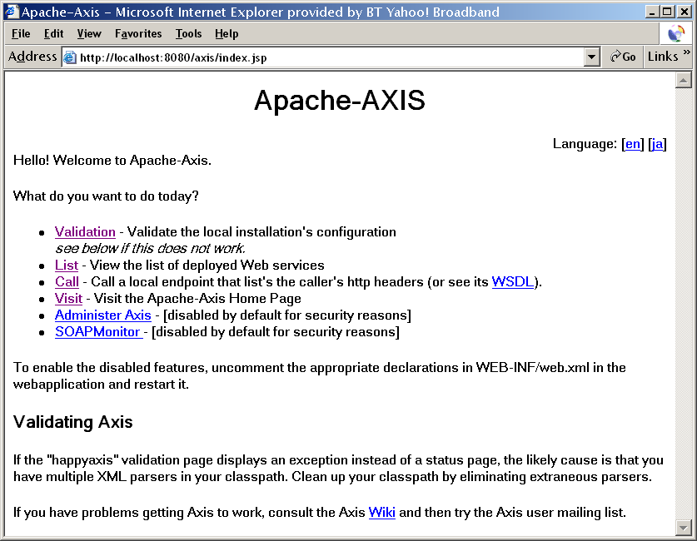

Slide 55
Summary: WS and the rest
 | RPC | CORBA | RMI | DCOM | WS-REST | WS-SOAP
Vendor | Sun | OMG | Sun | Microsoft | W3C | W3C
Platform | UNIX | Any | Any | Windows | Any | Any
Lang | C/C++ | CORBA | Java only | .Net only | Any | Any
Protocol | Sockets | IIOP | IIOP | Sockets | HTTP | HTTP
Broker | No | Yes | No, but separate registry | No, but separate registry | No | No
Proxy | No | Client & Server | Server | Client & Server | Server | Client & Server
Data types | Binary only | Primitive and object | Primitive and serializable | Primitive and serializable | Primitive and JSON | Primitive and XML

